Slide 1
FYP Final Evaluation
AUTOINSPECT
Automated Inspection Technique for Surgical Instruments
Team Members
1. Muhammad Saqib i190494
2. Vara Ali i190502
Supervisor :- Dr. Atif Aftab Ahmad Jillani
External Supervisor :- Dr Kashif Sagher

Slide 2

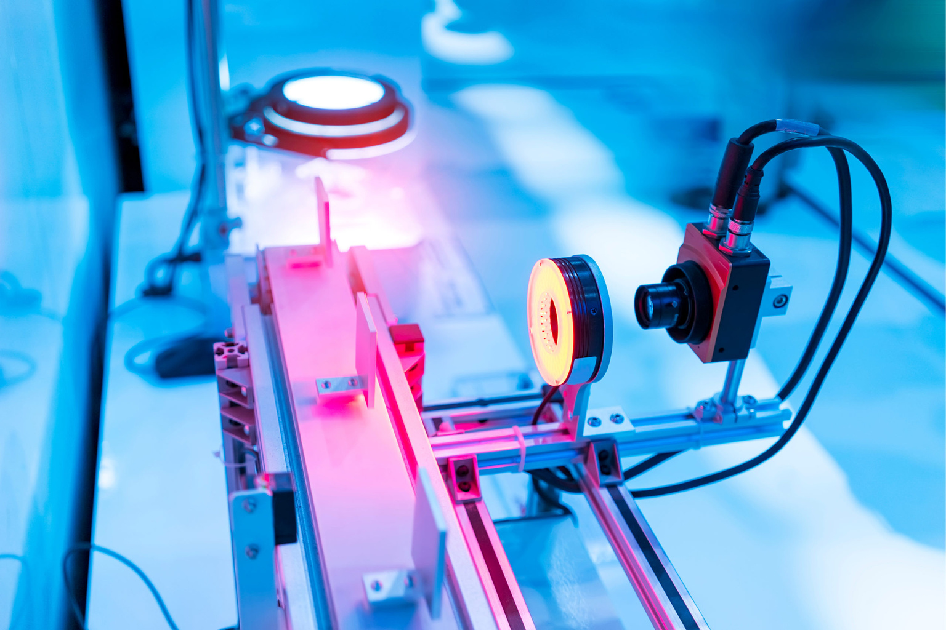
Quick Recap
AUTOINSPECT
Surface level inspection of surgical instruments to visually examine if they are free from manufacturing faults i.e., cracks , pores , corrosion, tucks and scratches
Classification of surgical instruments , detection of fault type , size , shape and location

Slide 3
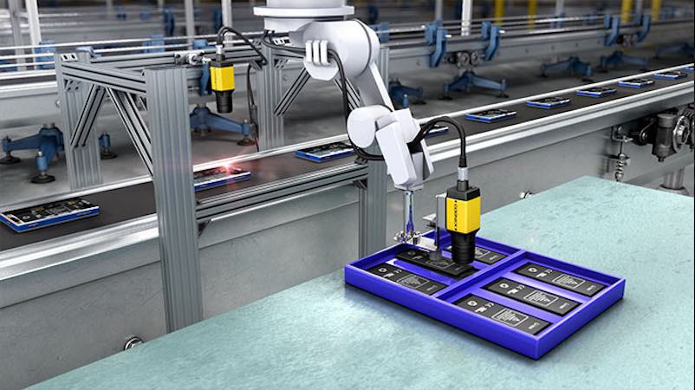
Work Done in
ITERATION-II
Dataset generation for all other type of surgical instruments along with covering all types of defects like cracks , pores , corrosion, tucks and scratches
Fine Tunning YOLO Model to get better results .
Developing a custom CNN best suitable for our use-case

Slide 4
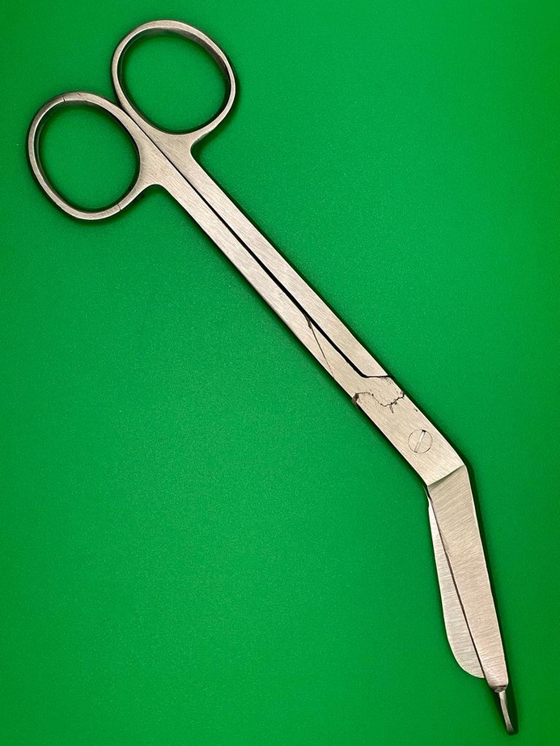
DATASET
GENERATION
Dataset generation for all other type of surgical instruments covering all types of defects
Forceps , Scissors , Scalpel , Wax Probes and Needle Holders are the types of instruments which are captured
Corrosion and Stains are the defects added during this iteration
Solving class imbalance problem through Selective Augmentation

Slide 5

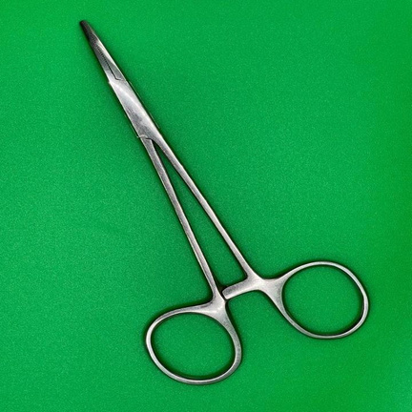
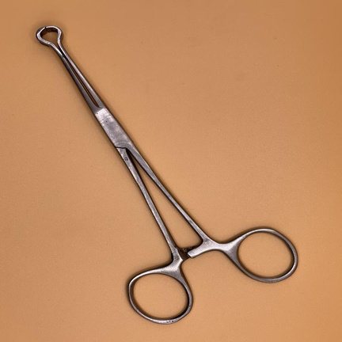
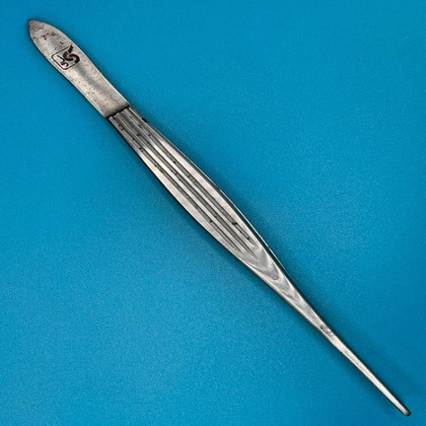
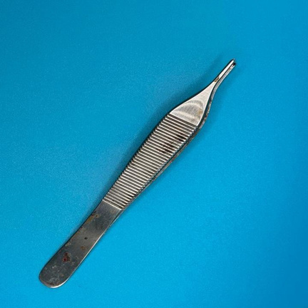
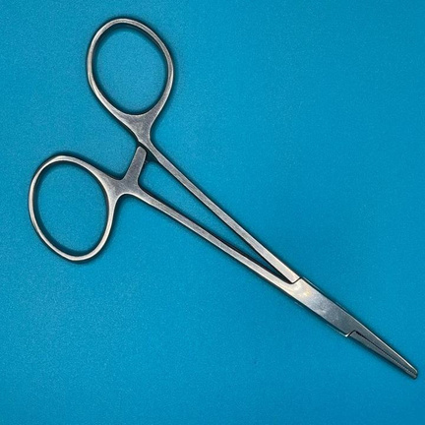
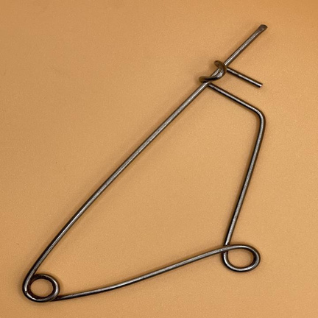
Instrument Categories Covered
Forceps
Dissecting Forceps
Babock Tissue Forceps
Dissecting Forceps
Tissue Forceps
Artery Forceps
Mayo Forceps

Slide 6
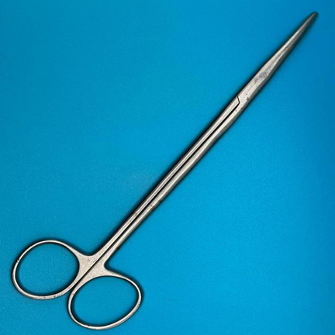
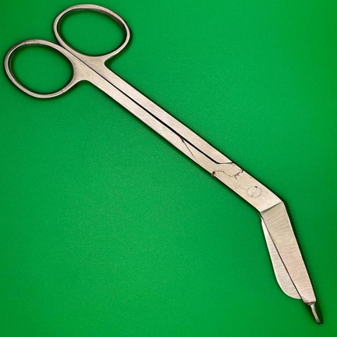
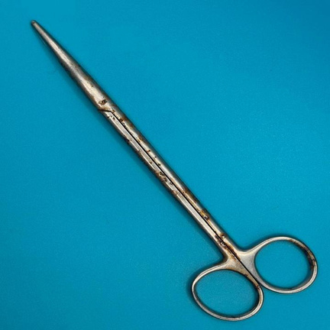
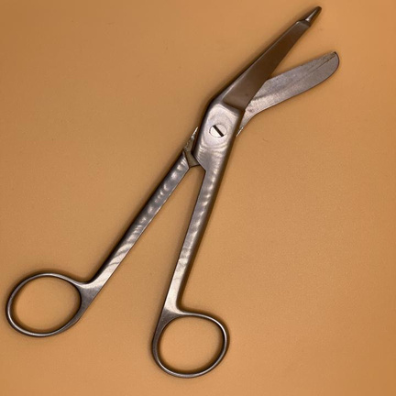
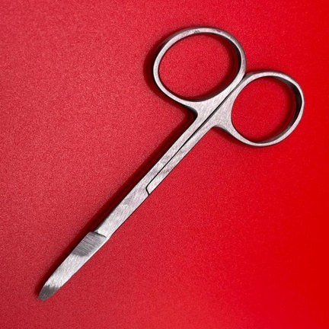
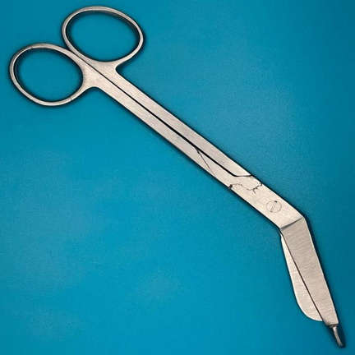
Instrument Categories Covered
Scissors
Curved Dissecting Scissor
Bandage Scissor
Curved Dissecting Scissor
Bandage Cutting Scissor
Dressing Scissor
Bandage Scissor

Slide 7
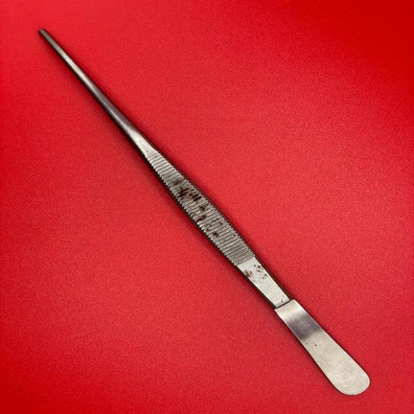
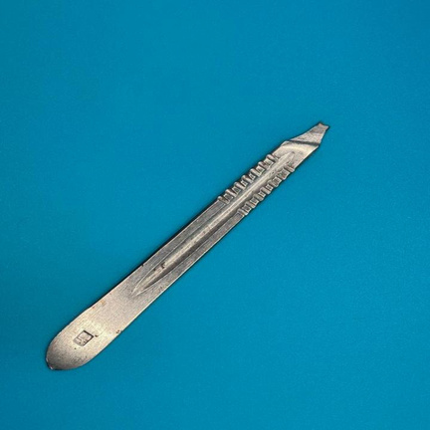
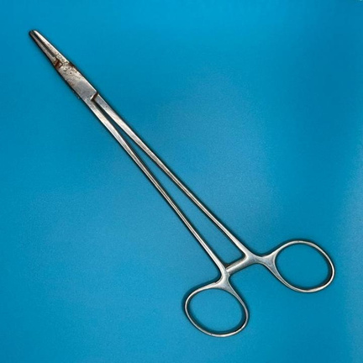
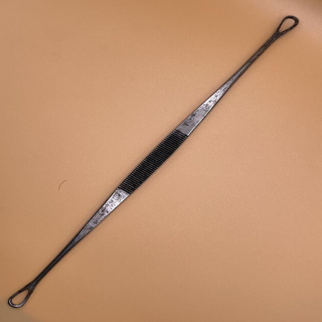
Instrument Categories Covered
Scalpel
Pencil Grip Scalpel
Palmar Grip Scalpel
Miscellaneous
Needle Holder
Wax Probe

Slide 8
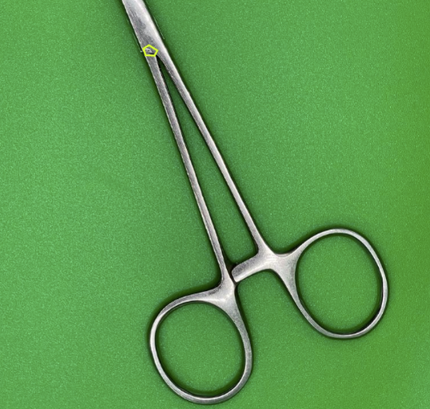
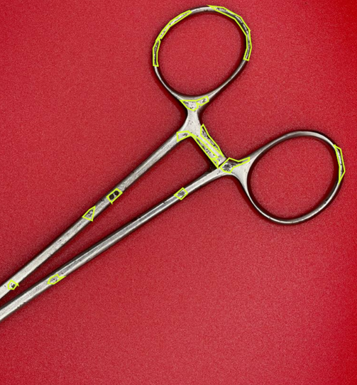
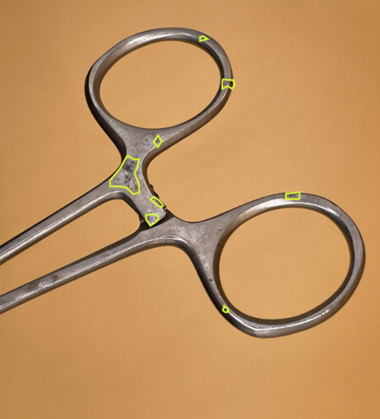
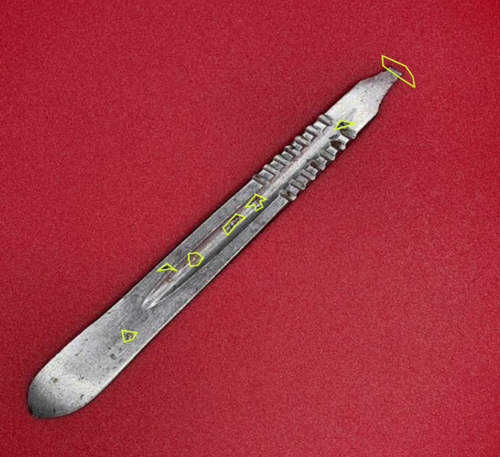
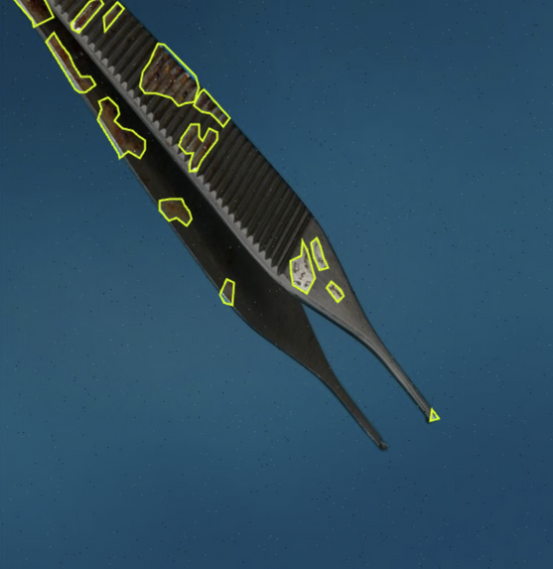
Defect Categories Covered
Pores
Pits
Stains & Scratches
Broken
Cracks
Corrosion / Rusting

Slide 9
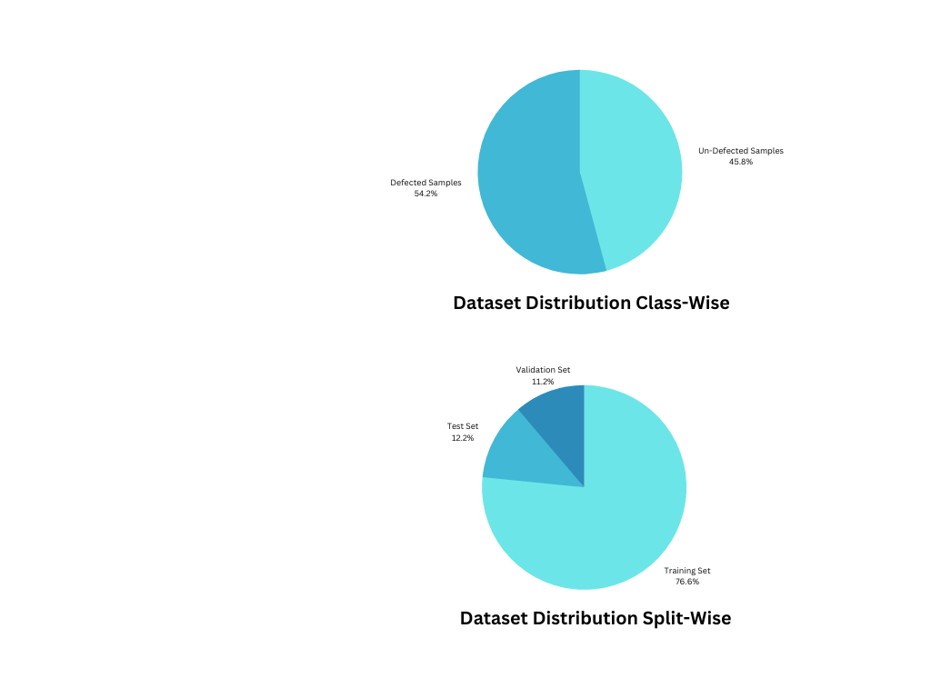
Summarized
DATASET STATS
Total Images in Dataset :- 3746
Train Test and Validation Split
(75% , 12.5% & 12.5%) approx
Defected Samples :- 1716
Un-Defected Samples :- 2030

Slide 10
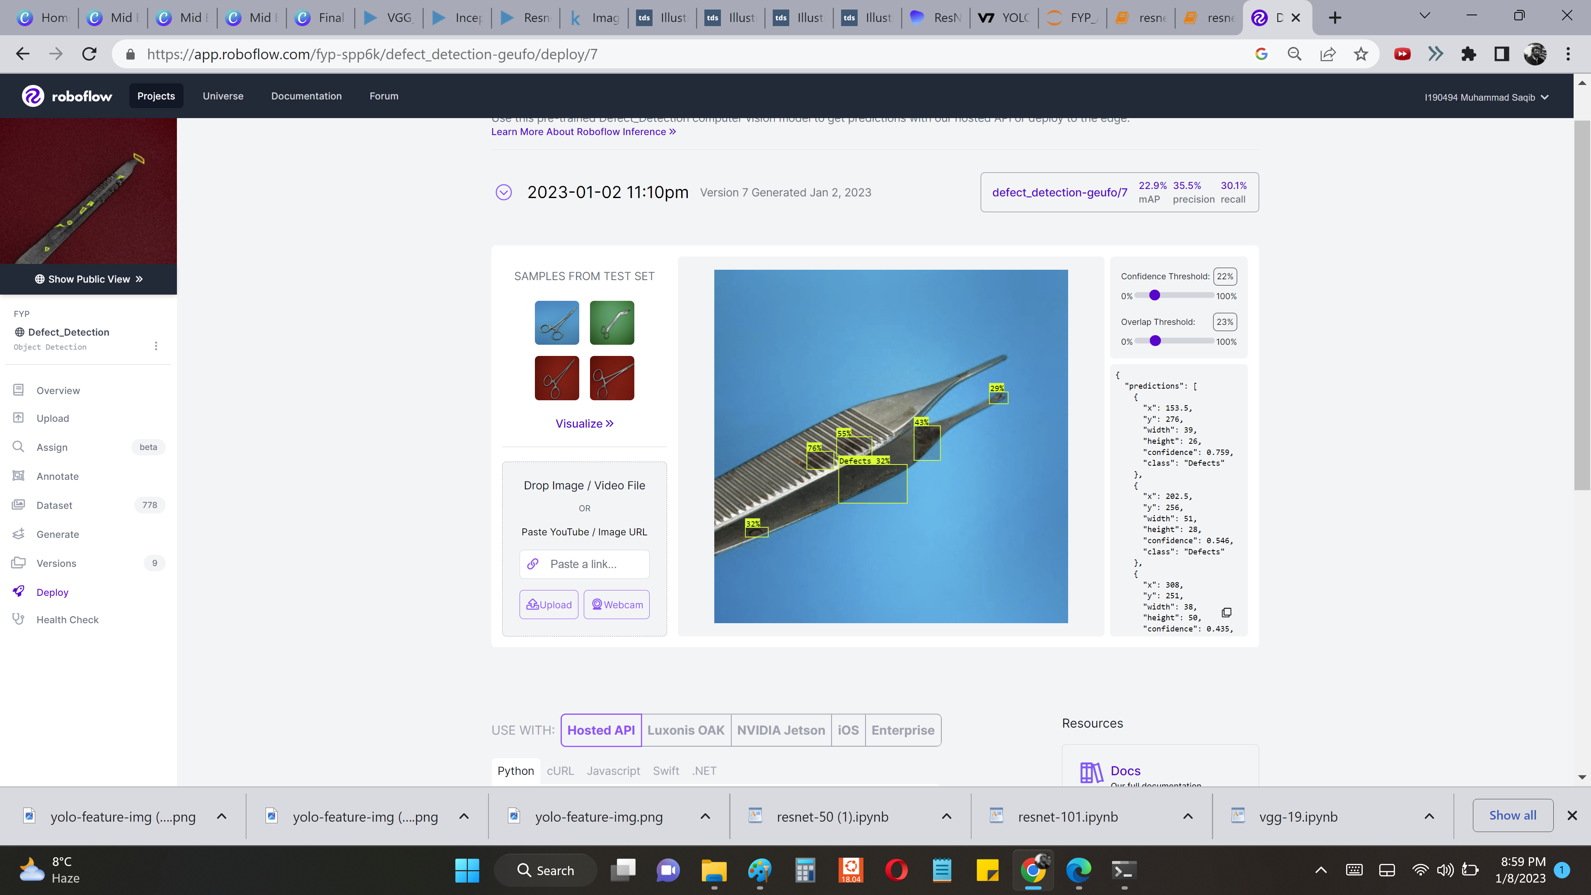
Fine-Tunning Modifications
YOLO MODEL
Fine tuning the pre-trained YOLOv5 as the dataset was increased
I. Freezing Layers
Transfer Learning
To use the already learned features of the pre-trained model for new tasks
Overfitting
Freezing the lower layers to avoid becoming too specific for our training data
II. Hyperparameters Evolution
Other hyperparameters including learning rate, batch size, number of epochs were changed using test and trial techniques to achieve an optimal value

Slide 11

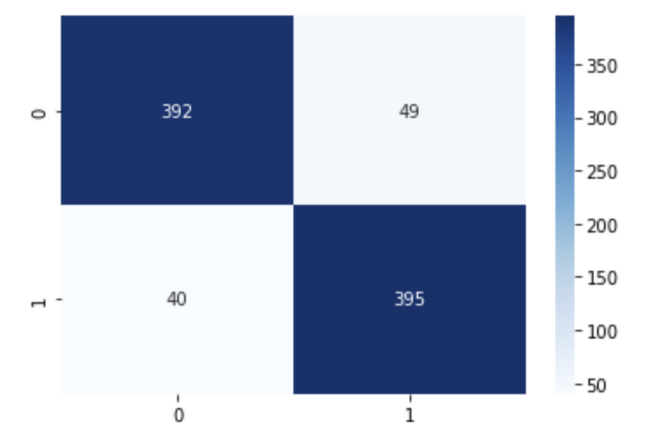
COMPARSION
YOLOv5s VS YOLOv7
v5s
i. simpler architecture, faster training hence more suitable for real time applications
ii. mAP: 55.0%
Precision = 0.920
Accuracy = 0.89
Confusion Matrix

Slide 12
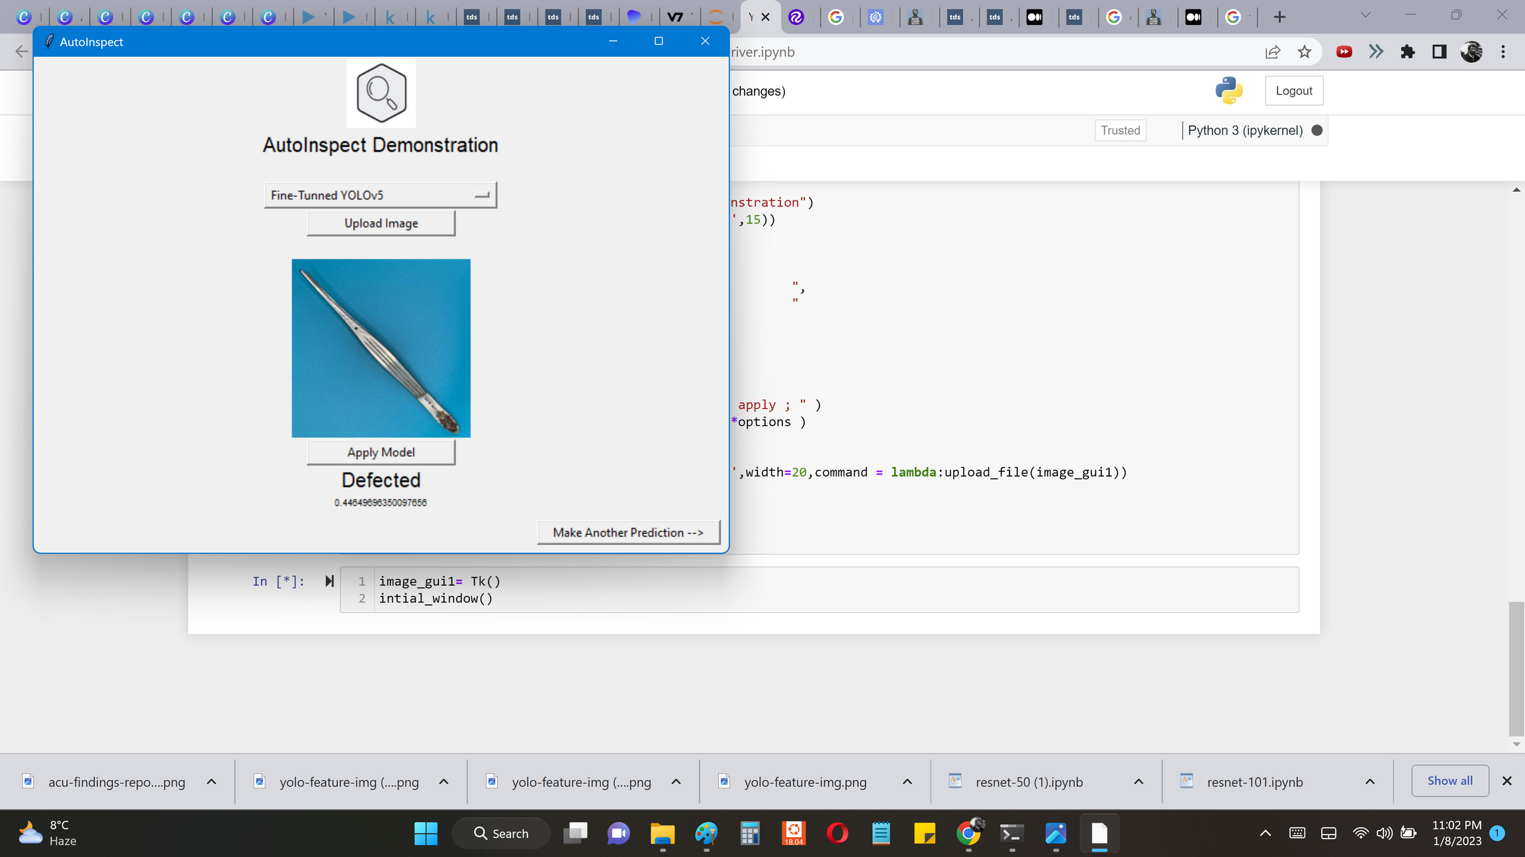
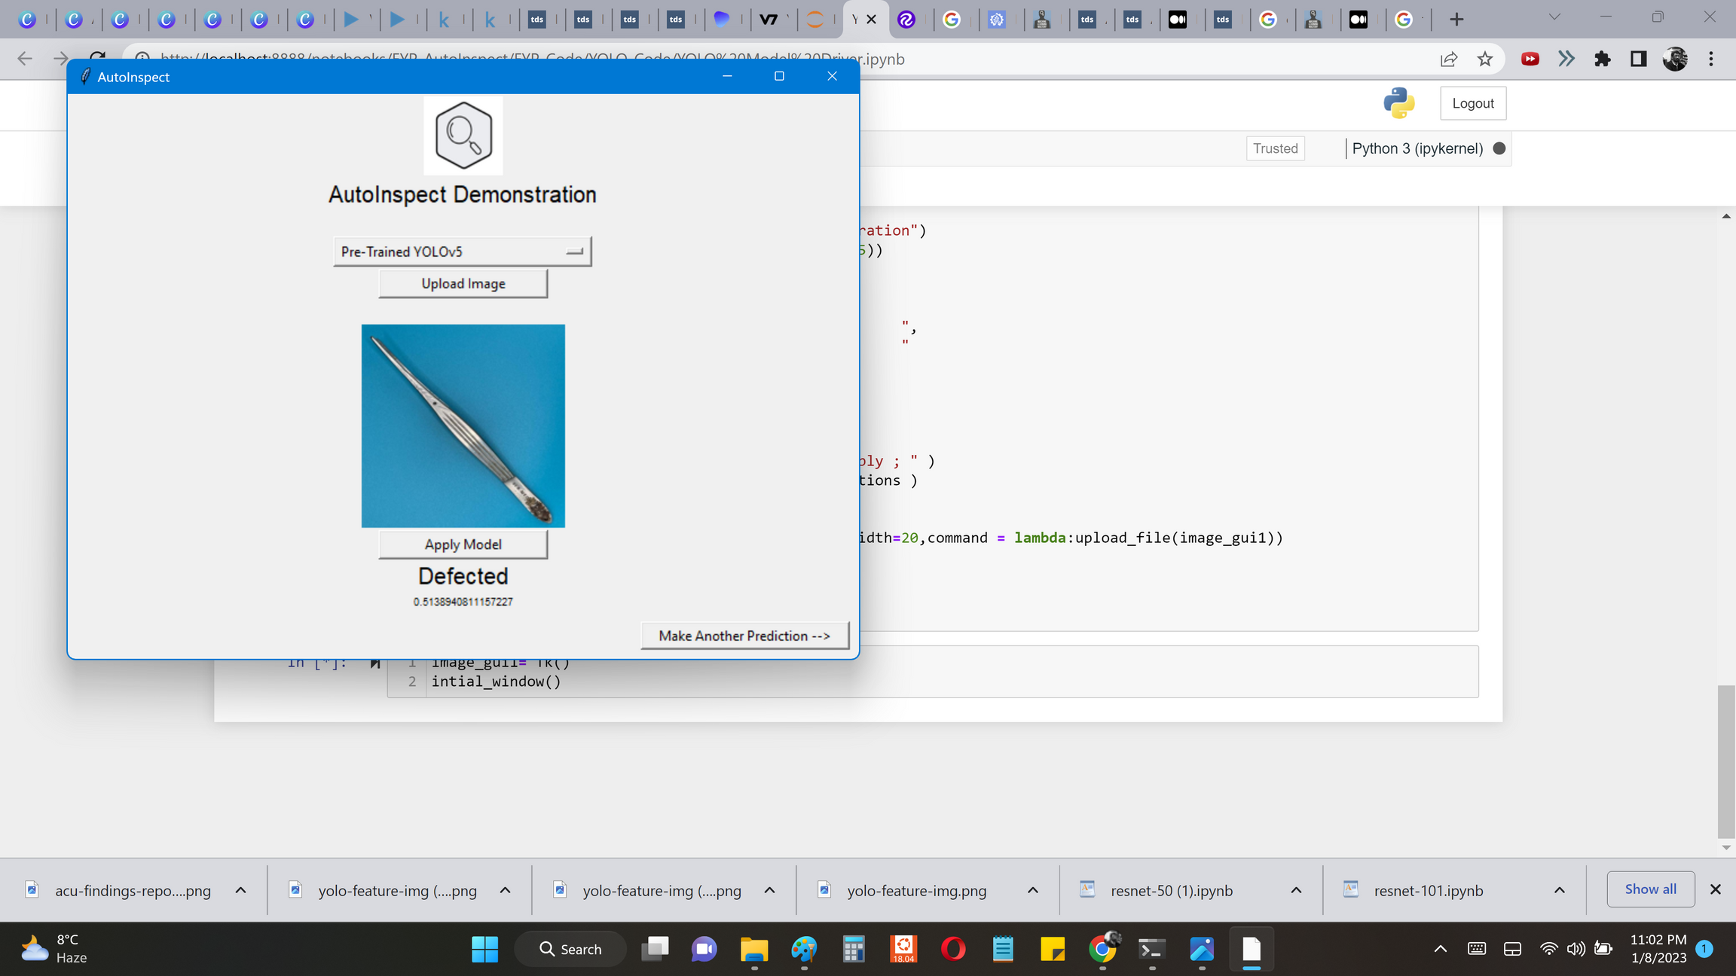
Results
Fine-Tunned YOLOv5s
Fine-Tunned YOLOv5s performed better in terms of both accuracy and the time of inference as compared to the one with pre-trained weights

Slide 13
Custom Classification CNN Model
DEFECT-NET
There ain't any specified mechanism to decide CNN architecture for custom use-case .
PRINCIPLES
Use Famous Architectures as base-line / inspiration :-
Alex-Net , Le-Net , Res-Net 50 , Res-Net 100 , VGG-19 & InceptionResNetV2
Borrow ideas through literature review :-
Defect Detection in Steel Structures , Cracks Detection in Concrete Infrastructure
Experimentation :-
Number of hidden layers , kernel size , stride , activation function & pooling function
Intuition combined with search :-
Auto-Keras Function

Slide 14

Principle based
FINDINGS
Using adequate number of layers to avoid over-fitting and under-fitting
Follow bottle-neck structure to uncover the complex features
Min-Pooling or Average-Pooling instead of Max-Pooling
Number of channels in feature space must be low in the start & should increase gradually
Padding=same as defect may exist on borders

Slide 15
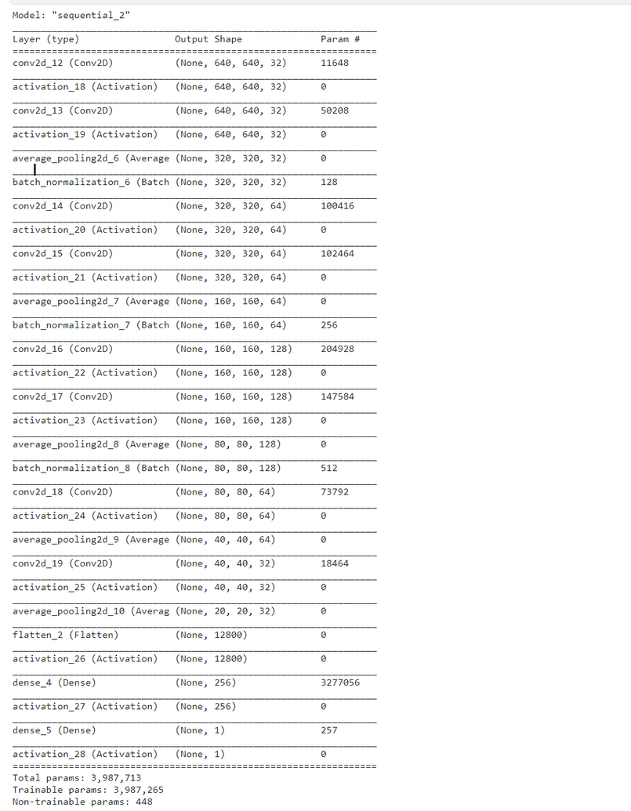
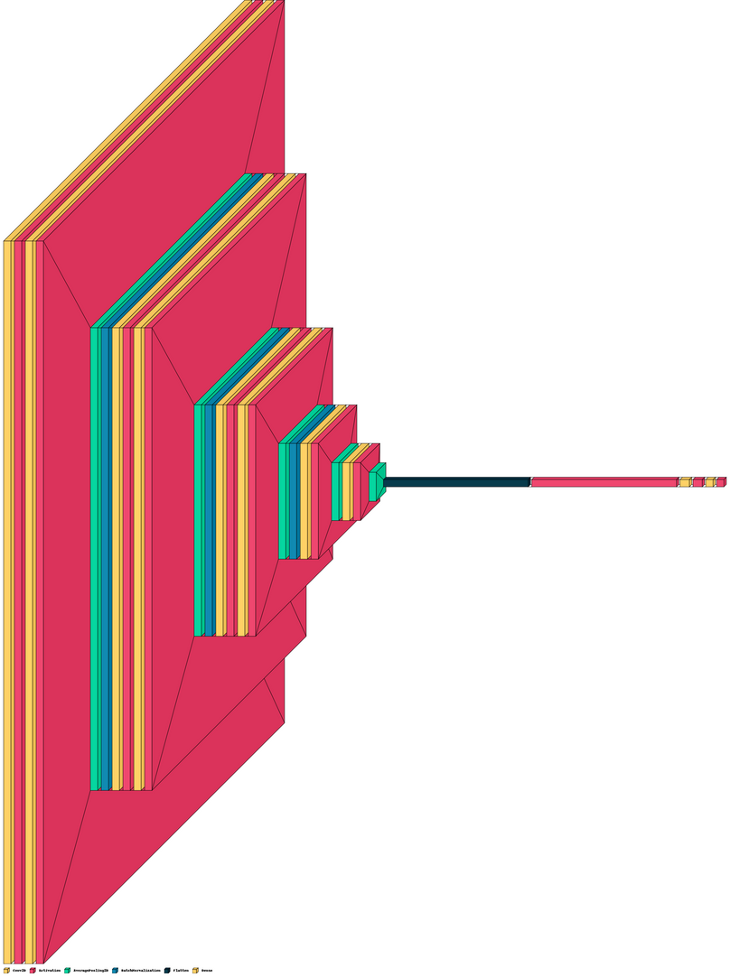
DEFECT-NET ARCHITECTURE

Slide 16
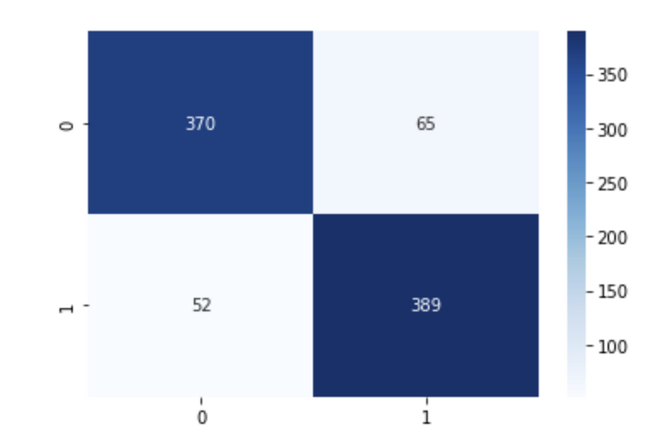
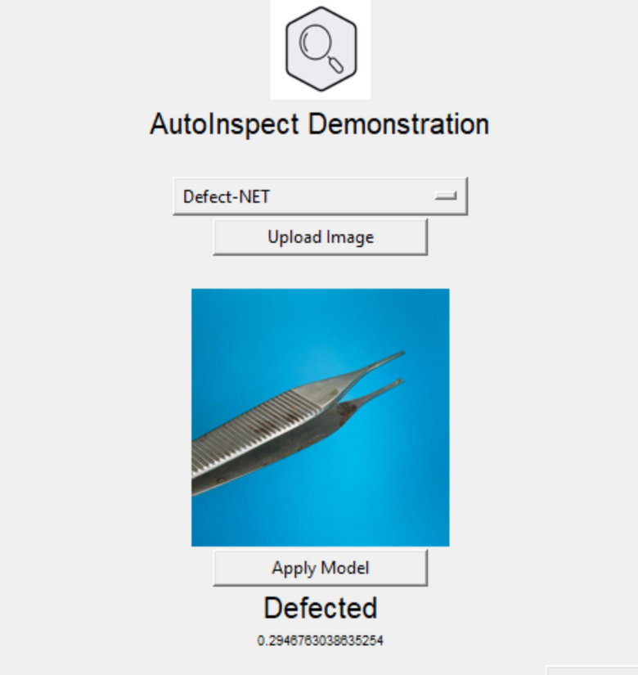
CLASSIFICATION RESULTS
DEFECT-NET
Confusion Matrix
Precision = 0.88 , Accuracy = 0.865
Detection Results

Slide 17
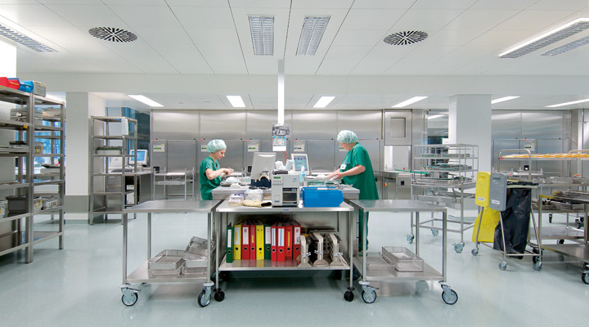
Iteration-II
CONCLUSION
Using Defect-NET for classification of the surgical instruments
Using YOLOv5s for defect localization and type prediction

Slide 18
WAY FORWARD FOR FYP-II
Defect type , size and shape detection
Integration of Web Interfaces with Model & Computational Unit
Prototype Proposal for Automated Image Acquisition
PROJECT
LIVE DEMONSTRATION

Slide 19
THANK YOU
ANY QUESTIONS ?
FYP Final Evaluation

